Slide 1
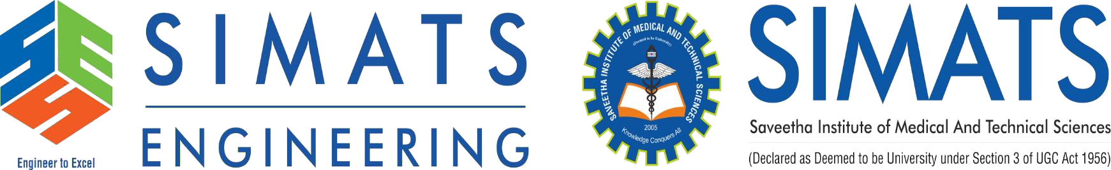
TECHNICAL PRESENTATION Selecting an Appropriate SDLC Model for Mobile App Development
Presented by : Dhaanush Rajan - 192421162
Subject code: CSA1110
Subject: OBJECT ORIENTED ANALYSIS AND DESIGN
Guide name : Dr. A. MANIMARAN

Slide 2


A company develops a Mobile Learning Application where customer requirements change frequently. Compare Agile, Waterfall, and Spiral models. Analyze their advantages and limitations and recommend the most suitable SDLC model with justification.

Slide 3
OBJECTIVE
To compare the Agile, Waterfall, and Spiral SDLC models, analyze their advantages and limitations, and identify the most suitable model for developing a Mobile Learning Application with frequently changing customer requirements. The objective is to recommend the best SDLC approach that ensures flexibility, continuous customer feedback, high software quality, and timely delivery.

Slide 4

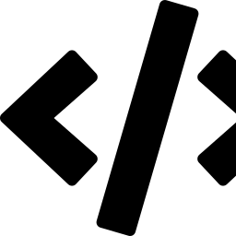

Frequent Requirement Change in a Mobile Learning App
Evolving Learner Needs
Platform Fragmentation
Market Feedback Loops
Students and instructors request new quiz types, gamification, and content formats mid-course.
iOS/Android OS updates and new device form factors force continuous UI and API rework.
App-store reviews and analytics reveal usability gaps only after real users engage.

Slide 5



Waterfall Model
The Waterfall Model is a traditional linear and sequential SDLC model in which each phase of software development is completed before moving to the next.
Advantages
Limitations
Simple and easy to understand and implement.
Well-defined phases with clear documentation.
Easy to manage due to a structured approach.
Suitable for projects with fixed and well-defined requirements.
Difficult to accommodate changing requirements.
Customer involvement is limited after the requirement phase.
Testing is performed only after development is completed.
Changes made during later stages are costly and time-consuming
Requirements
Design
Implementation
Testing
Deployment

Slide 6

Agile Model
Short, repeated iterations (sprints) deliver working, testable increments — requirements are re-prioritized every cycle based on stakeholder feedback.
Plan
Advantages
Supports frequent changes in customer requirements.
Delivers working software through short development cycles (sprints).
Encourages continuous customer involvement and feedback.
Improves software quality through regular testing and reviews.
Faster delivery of new features and bug fixes.
Enhances customer satisfaction with continuous improvements.
Release
Build
Sprint
Cycle
Limitations
Test & Review
Requires active customer participation throughout the project.
Needs experienced and well-coordinated development teams.
Project scope may change frequently, making cost and schedule estimation difficult.
Documentation may be less detailed compared to traditional models.

Slide 7

Spiral Model
Plan Next
Phase
Determine
Objectives
The Spiral Model is a risk-driven and iterative SDLC model that combines elements of both the Waterfall and Prototyping models. Development progresses through repeated cycles (spirals), where each cycle includes planning, risk analysis, engineering, testing, and customer evaluation.
Advantages
Focuses on identifying and managing project risks.
Supports iterative development with continuous improvements.
Allows customer feedback after each development cycle.
Suitable for large, complex, and high-risk projects.
Changes can be incorporated during each iteration.
Limitations
Expensive due to repeated development cycles and risk analysis.
Complex to manage and requires experienced developers.
Time-consuming for small or medium-sized projects.
Success depends on accurate risk assessment.
Develop &
Test
Risk
Analysis

Slide 8


RECOMMENDATION
Agile Is the Recommended SDLC Model
Continuous adaptation
Fast time-to-value
Sprint-based delivery absorbs frequent requirement changes from students, instructors, and app-store feedback without derailing the schedule.
Working increments every 1–4 weeks let the company validate features with real learners early and often.
Built-in stakeholder loop
Manageable risk profile
Sprint reviews keep product owners, teachers, and UX researchers directly engaged in shaping the backlog.
For an app of this scale, Agile's lighter-weight risk handling is sufficient — Spiral's overhead isn't justified.

Slide 9
Why Not Waterfall or Spiral Alone?
Why Not Waterfall?
The Waterfall model follows a fixed, sequential process, making it difficult to accommodate changing customer requirements.
Customer feedback is mainly collected at the beginning, leaving little opportunity for changes during development.
Testing is performed only after the development phase, so issues are identified late.
Modifying features after implementation is costly and time-consuming.
Why Not Spiral?
The Spiral model is primarily designed for large, complex, and high-risk projects.
It involves extensive risk analysis, increasing development cost and time.
Managing multiple iterations and risk assessments requires experienced teams.
For a Mobile Learning Application, the complexity and cost of the Spiral model are usually unnecessary.

Slide 10
Conclusion
Neither the Waterfall nor the Spiral model alone is the best choice for a Mobile Learning Application with frequently changing requirements. Agile is the preferred SDLC model because it provides flexibility, continuous customer feedback, frequent software releases, and faster adaptation to changing needs, resulting in higher customer satisfaction and better software quality.

Slide 11
THANK YOU!

